Slide 1
CVIP
Computer Vision Image Processing tool
Kotenkov Maksim
Makanin Kirill
Yakovleva Valeria
Mentor: Parnachev Vladimir Vladimirovich
https://github.com/CV-goes-frr/CVIP
https://clck.ru/374DJf
Notes:
Hello everyone. For those who don’t know us, my name is Kirill and colleage’s names are Maxim and Valeria. Our team is developing CVIP - Computer Vision Image Processing tool. With the help of CVIP, the user is able to easily and efficiently edit photos by calling CVIP in a terminal as shown in the next slide.

Slide 2
Token example:
[label1]action:param1:param2[label2]
Notes:
Max: The prompt for the CVIP tool is formed with such tokens:
[(-i=)input_label]action:parameter1:parameter2...[(-o=)output_label]... (--parallel_processes=2)
Also, You can mark a label to be the input image or the output image:
* [-i=input_image.format]action:parameters[-o=output_image]
This prompt will take input_image.format, apply the action with parameters You set and then create the output_image.jpg as the result. Labels with -o= can be an intermediate result, that you want to save.

Slide 3
Token example:
[label1]action:param1:param2[label2]
[-i=label0.png]action:param1:param2[label1]

Slide 4
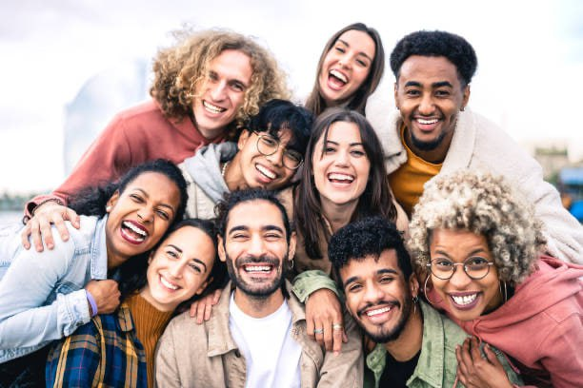
Token example:
[label1]action:param1:param2[label2]
[-i=label0.png]action:param1:param2[label1]
label0.png

Slide 5
Token example:
[label1]action:param1:param2[label2]
[-i=label0.png]action:param1:param2[label1]
label0.png
[label2]action:param1:param2[-o=label3]

Slide 6
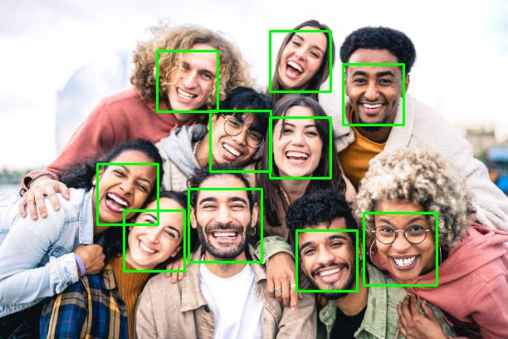
Token example:
[label1]action:param1:param2[label2]
[-i=label0.png]action:param1:param2[label1]
label0.png
[label2]action:param1:param2[-o=label3]
label3.jpg

Slide 7
Actions list:
* crop:x1:y1:x2:y2
* nn_scale_with_factor:scale_factor
* bilinear_scale_with_factor:scale_factor
* scale_to_resolution:width:height
* face_blur:blur_coefficient
* face_detection
* mask:mask_filename.format

Slide 8
[-i=photo.jpg]crop:0:0:600:400[cropped][cropped]face_detection[-o=detected][cropped]mask:face.jpg[-o=masked]
[-i=photo.jpg]face_blur:5[-o=blurred_original_size][blurred_original_size]scale_to_resolution:1920:1080[-o=blurred_good_resolution] --parallel_processes=4

Slide 9
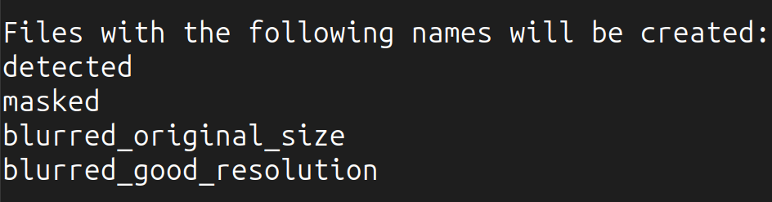
[-i=photo.jpg]crop:0:0:600:400[cropped][cropped]face_detection[-o=detected][cropped]mask:face.jpg[-o=masked]
[-i=photo.jpg]face_blur:5[-o=blurred_original_size][blurred_original_size]scale_to_resolution:1920:1080[-o=blurred_good_resolution] --parallel_processes=4
Notes:
Max: Let’s check the results we’ve got. You can see what files will be created *there*...

Slide 10
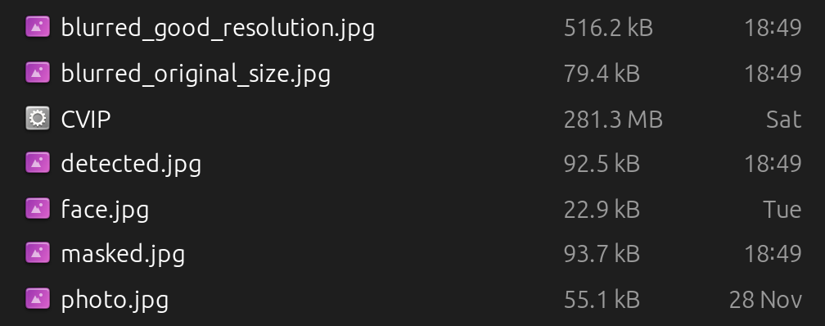
[-i=photo.jpg]crop:0:0:600:400[cropped][cropped]face_detection[-o=detected][cropped]mask:face.jpg[-o=masked]
[-i=photo.jpg]face_blur:5[-o=blurred_original_size][blurred_original_size]scale_to_resolution:1920:1080[-o=blurred_good_resolution] --parallel_processes=4

Slide 11
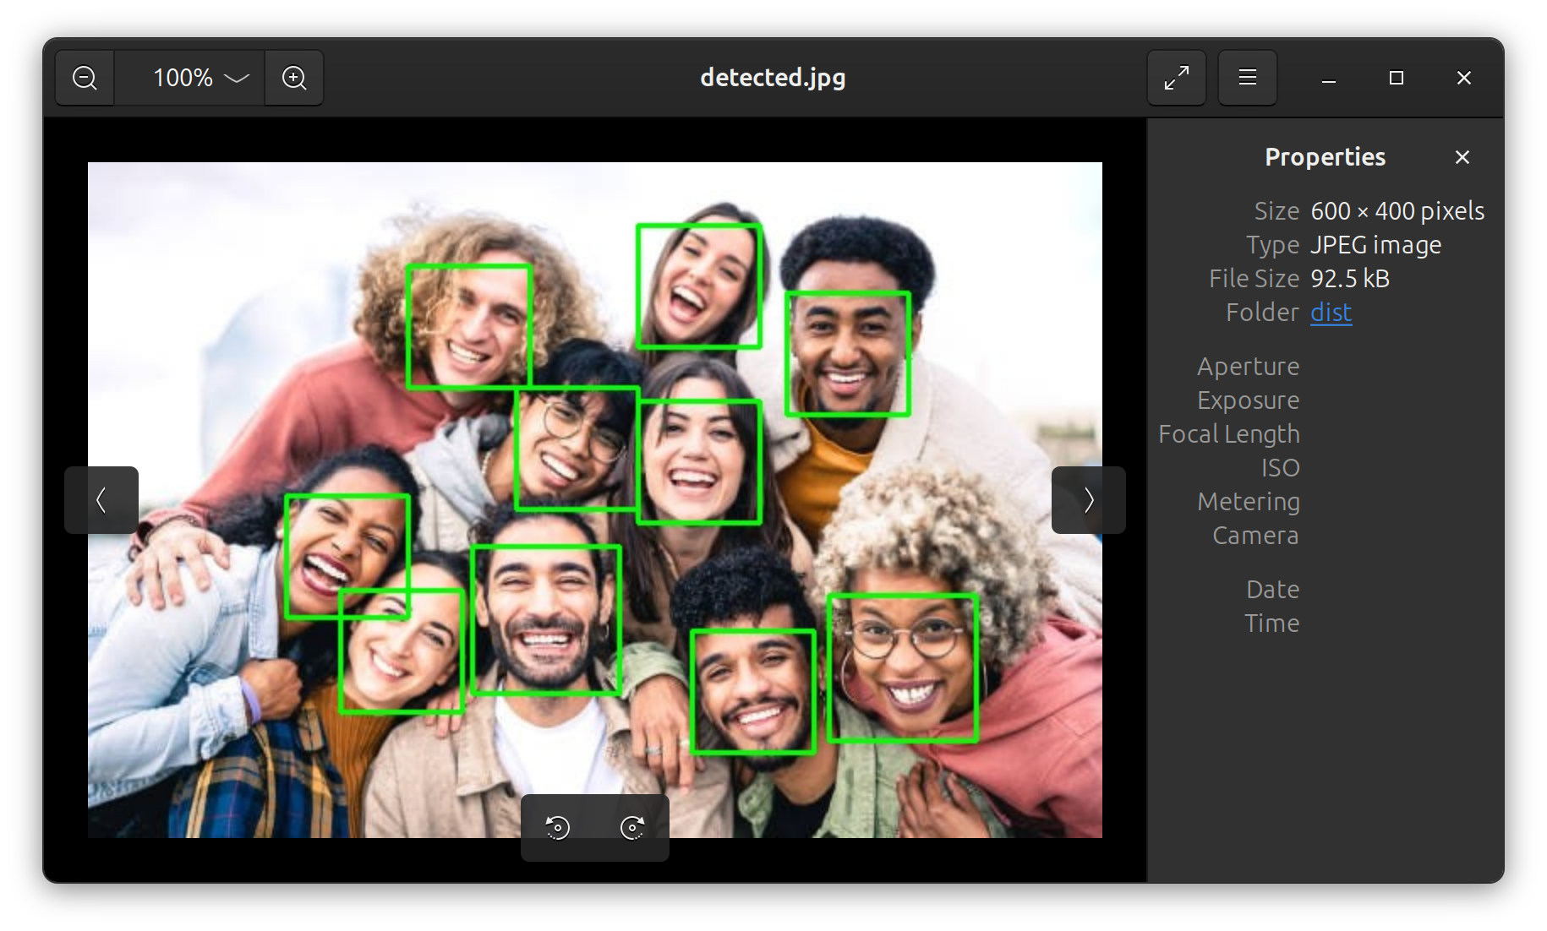
[-i=photo.jpg]crop:0:0:600:400[cropped][cropped]face_detection[-o=detected][cropped]mask:face.jpg[-o=masked]
[-i=photo.jpg]face_blur:5[-o=blurred_original_size][blurred_original_size]scale_to_resolution:1920:1080[-o=blurred_good_resolution] --parallel_processes=4

Slide 12

[-i=photo.jpg]crop:0:0:600:400[cropped][cropped]face_detection[-o=detected][cropped]mask:face.jpg[-o=masked]
[-i=photo.jpg]face_blur:5[-o=blurred_original_size][blurred_original_size]scale_to_resolution:1920:1080[-o=blurred_good_resolution] --parallel_processes=4

Slide 13

[-i=photo.jpg]crop:0:0:600:400[cropped][cropped]face_detection[-o=detected][cropped]mask:face.jpg[-o=masked]
[-i=photo.jpg]face_blur:5[-o=blurred_original_size][blurred_original_size]scale_to_resolution:1920:1080[-o=blurred_good_resolution] --parallel_processes=4

Slide 14
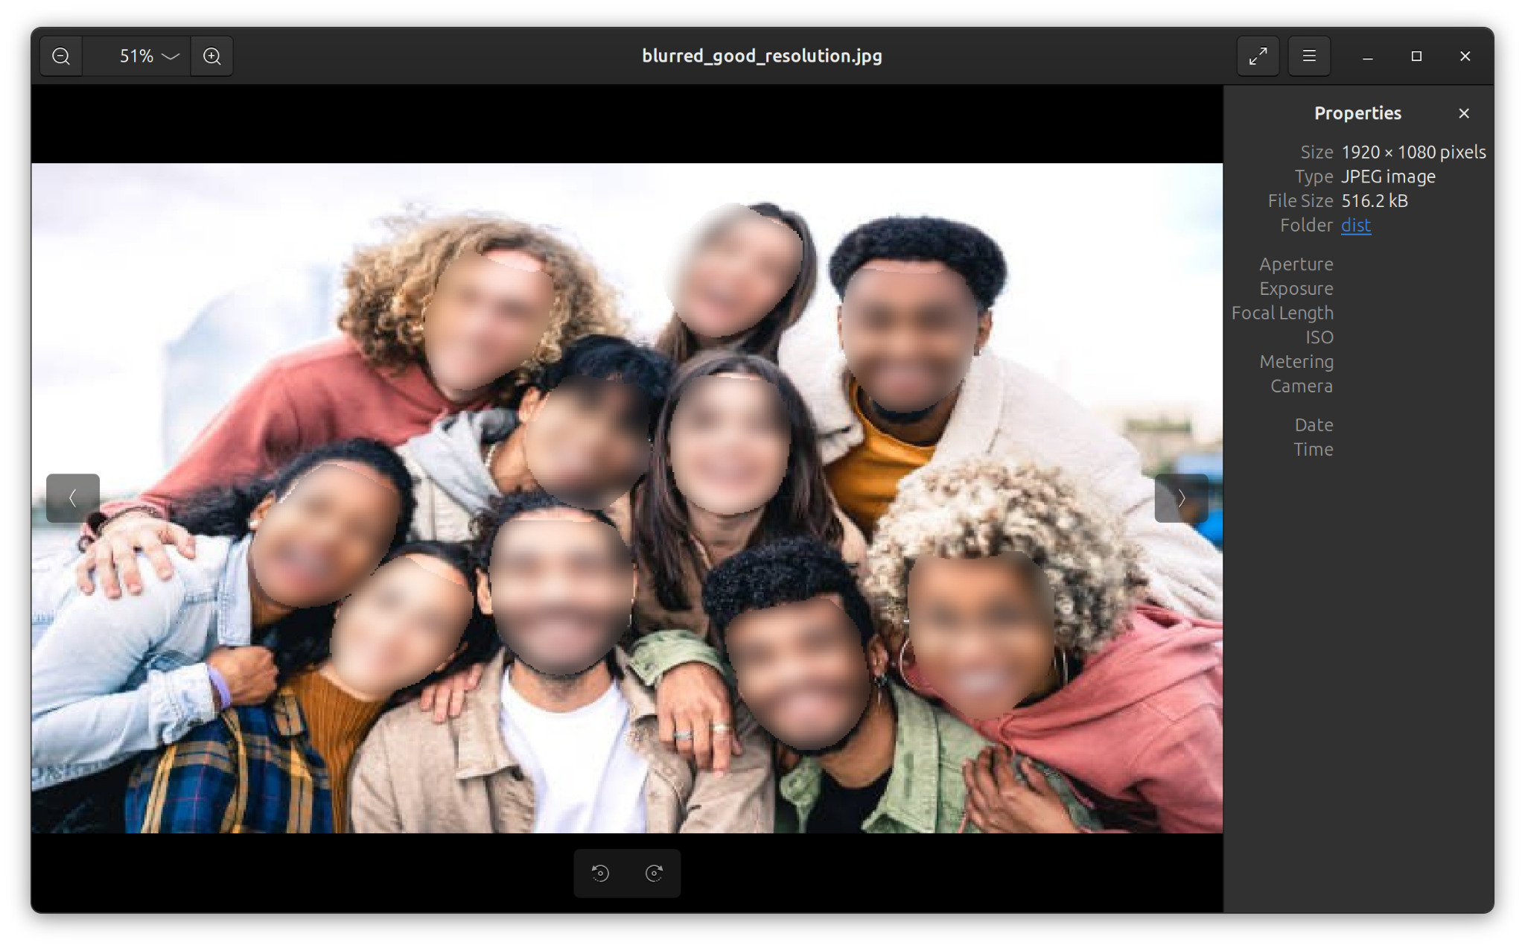
[-i=photo.jpg]crop:0:0:600:400[cropped][cropped]face_detection[-o=detected][cropped]mask:face.jpg[-o=masked]
[-i=photo.jpg]face_blur:5[-o=blurred_original_size][blurred_original_size]scale_to_resolution:1920:1080[-o=blurred_good_resolution] --parallel_processes=4

Slide 15

[-i=photo.jpg]crop:0:0:600:400[cropped][cropped]face_detection[-o=detected][cropped]mask:face.jpg[-o=masked]
[-i=photo.jpg]face_blur:5[-o=blurred_original_size][blurred_original_size]scale_to_resolution:1920:1080[-o=blurred_good_resolution] --parallel_processes=4

Slide 16
Now let’s look closer at the prompt from the previous slide

Slide 17
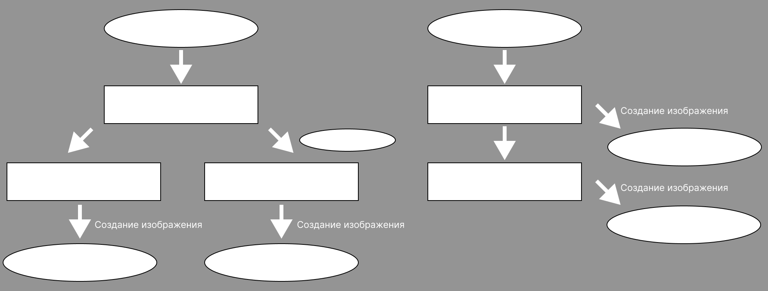
[-i=photo.jpg]crop:0:0:600:400[cropped][cropped]face_detection[-o=detected][cropped]mask:face.jpg[-o=masked]
[-i=photo.jpg]face_blur:5[-o=blurred_original_size][blurred_original_size]scale_to_resolution:1920:1080[-o=blurred_good_resolution] --parallel_processes=4
photo.jpg
photo.jpg
crop:0:0:600:400
face_blur:5
face_detection
cropped
blurred_original_size
scale_to_resolution:1920:1080
mask:face.jpg
face.jpg
blurred_original_size.jpg
detected
masked
blurred_good_resolution
blurred_good_resolution.jpg
detected.jpg
masked.jpg
Notes:
Max: When we call CVIP with the prompt, the dependency tree is pre-calculated. According to the dependencies of different actions, we call each action we need to get the result with caching calculations and saving interim results if we need them later (like, for other dependency relation).

Slide 18
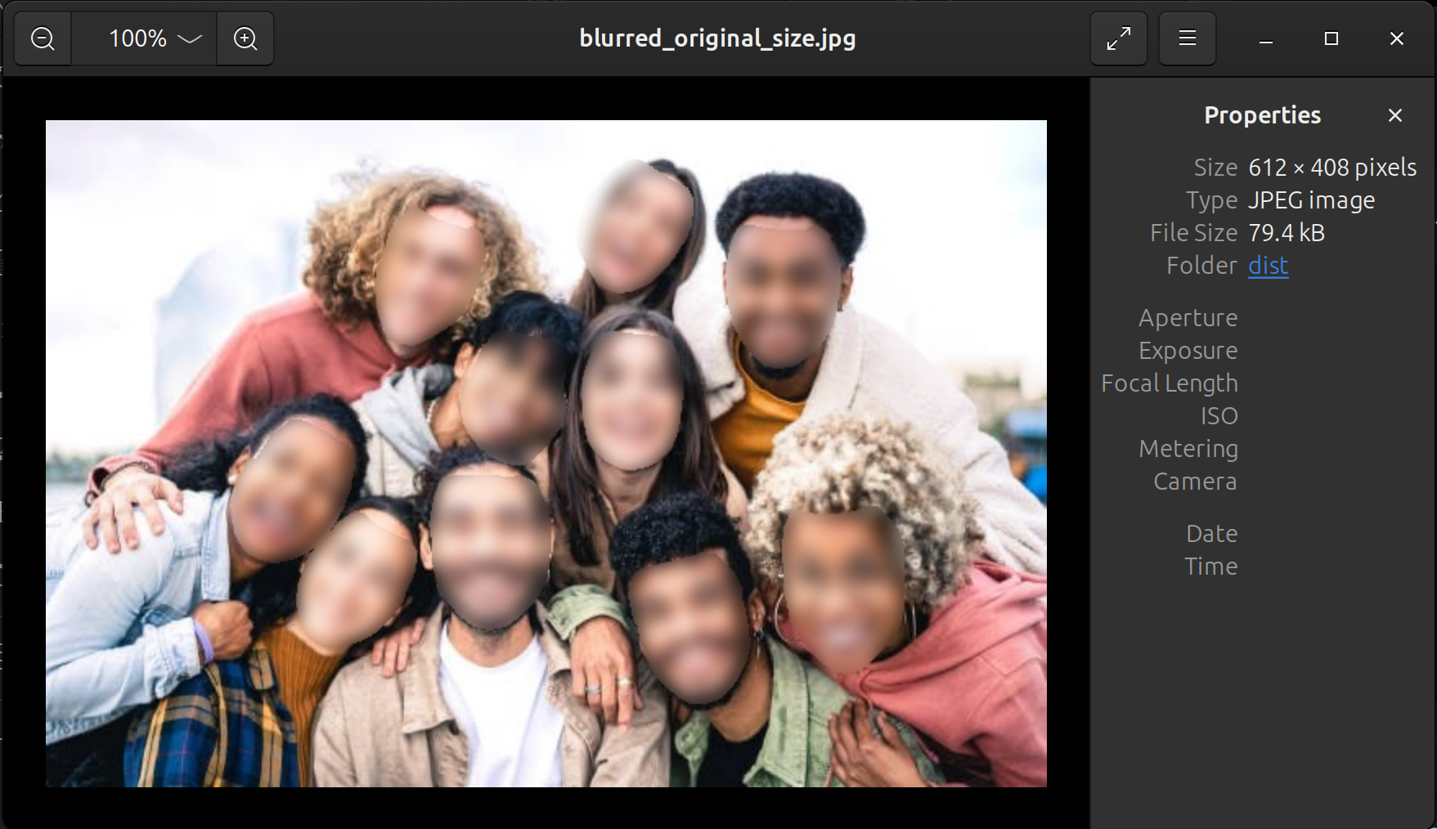
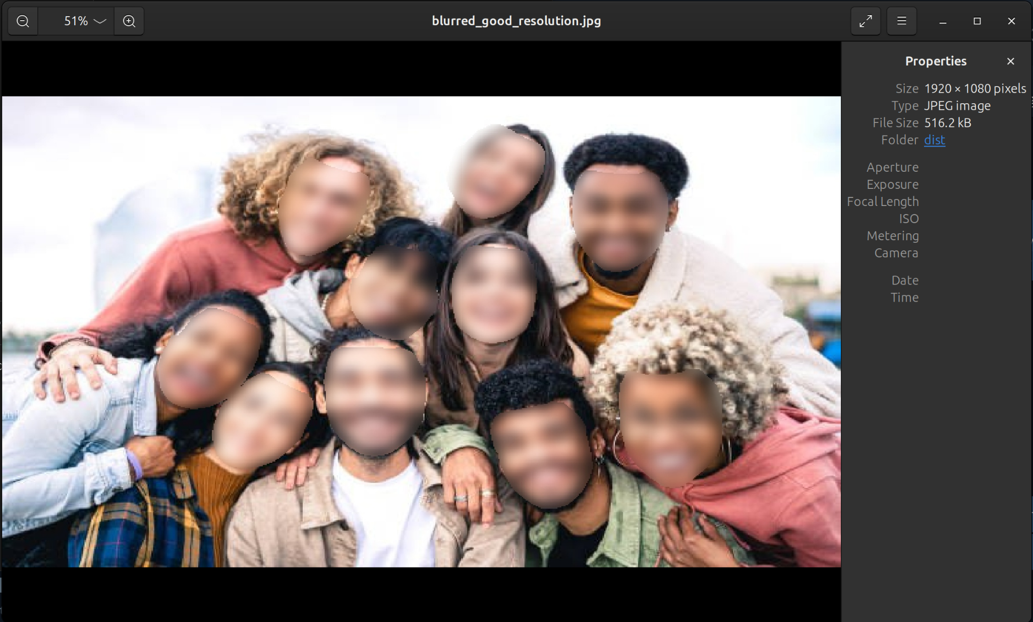
Image scaling
Original image
Resized image
Notes:
In our project, we have implemented scale filters using 3 methods of interpolation: the nearest neighbour algorithm,the Bilinear interpolation, the bicubic interpolation
As a result we use nearest neibhour and bilinear algorithm for upscaling and downscaling image with a desired coefficient. Also we implemented filter which can change resolution of image using bicubic interpolation.
Next, I’d like to talk about interpolation

Slide 19
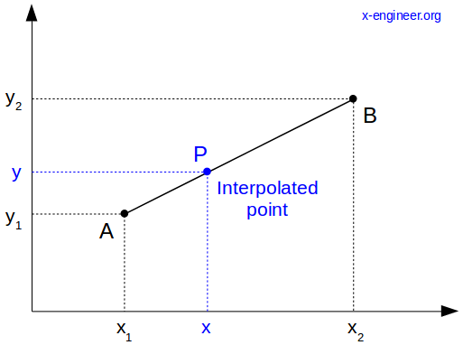
Interpolation

Slide 20
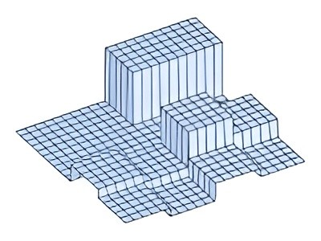
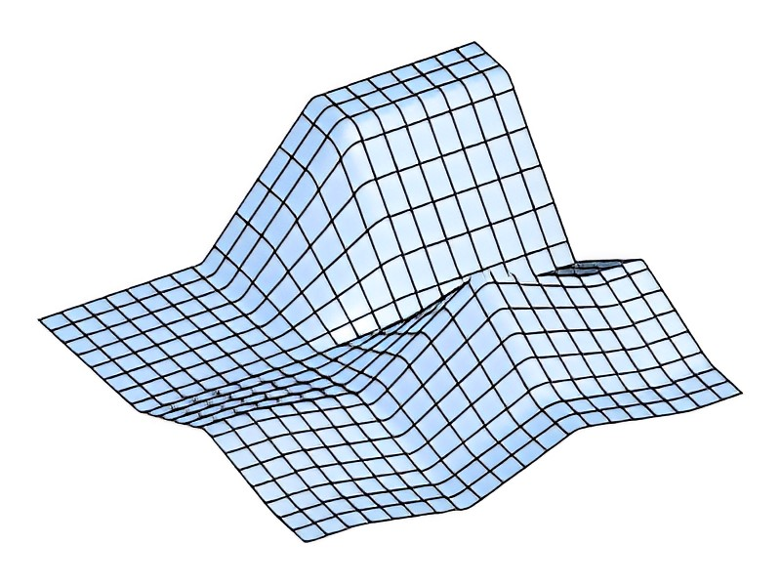
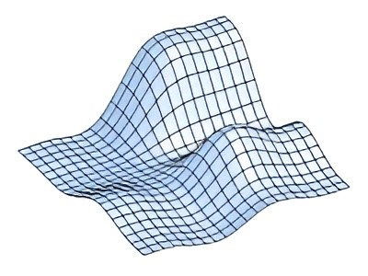
Types of interpolation
Nearest neighbors
Bilinear interpolation
Bicubic interpolation
Notes:
Interpolation is a method to estimate or predict unknown values between known data points by creating a smooth curve or function that passes through those points.
The nearest neighbour algorithm selects the value of the nearest pixel and doesn’t interpolate between values from other neighbouring pixels.
Bilinear interpolation is an algorithm that applies linear interpolation between pixel values in the x and y directions.
The bicubic method is similar to the bilinear algorithm however instead of linear interpolation, the weighting favours the values closer to the source pixel .

Slide 21
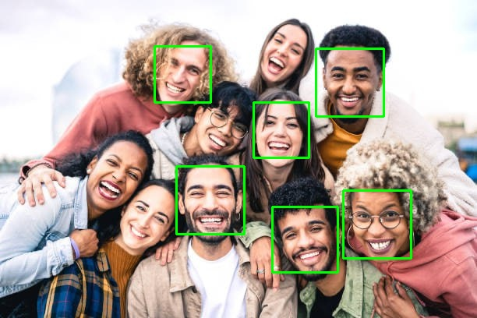
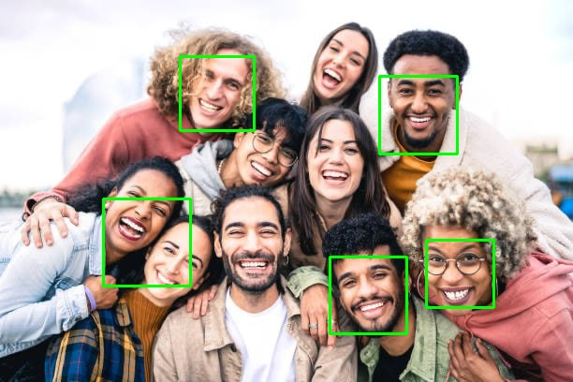
Models we’ve used for detection with comparison
Viola-Jones algorithm
with Haar cascade
dlib
mediapipe
with blazeface
Notes:
Lera: we’ve wanted to implement filters with use of face detection. We had to try several models and algorithms to find the better one. These are the ones we’ve tried: Viola-Jones algorithm with haarcascade model was good, but had troubles with detecting several faces on some images. Mediapipe with blazeface model is a popular one, but couldn’t recognize enough faces on some images. The dlib one showed us the best result on images with a lot of faces, so we’ve chosen this one.

Slide 22
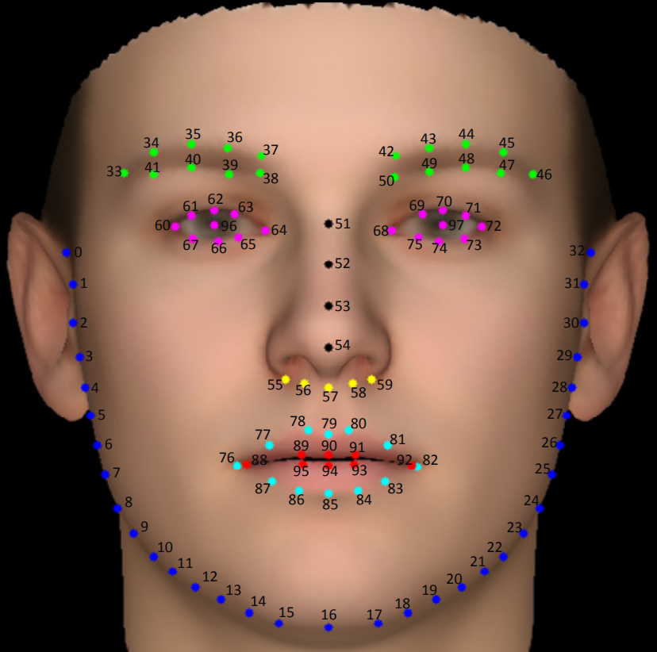
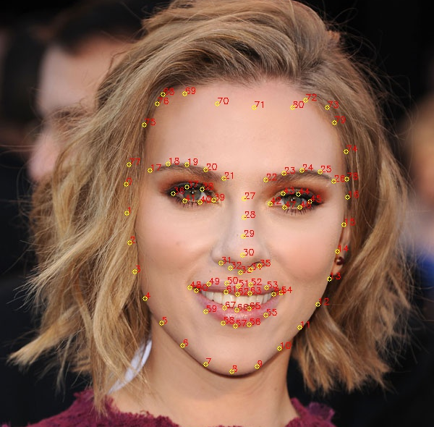
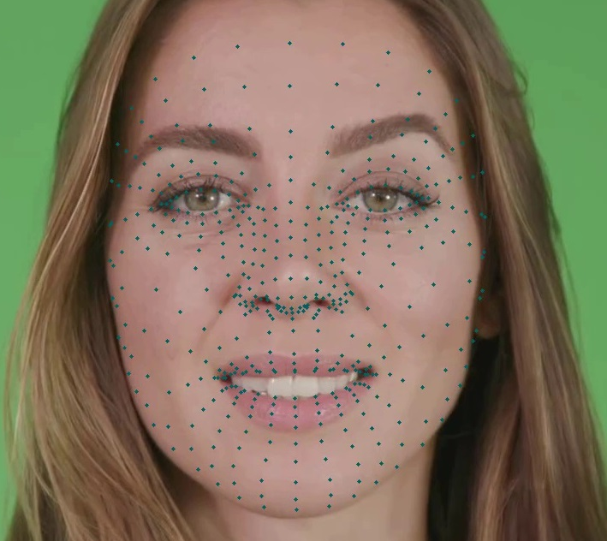
Face landmarks
dlib 68-points
dlib 81-points
blazeface 468-points
Notes:
Also we’ve wanted to implement face blurring and masking and we’ve needed face landmarks for it. There are also several models for this task. First attempt was with dlib with 68-points. It was okay, but we’ve faced some problems because of not recognising the forehead. Next we’ve tried blazeface with 468-points. And we have tried dlib with 81 points and it was the best one, because it is quite accurate and includes forehead points.

Slide 23
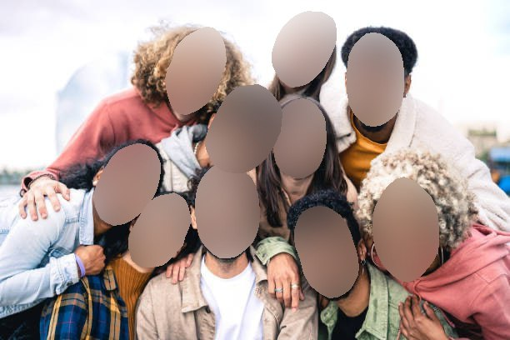
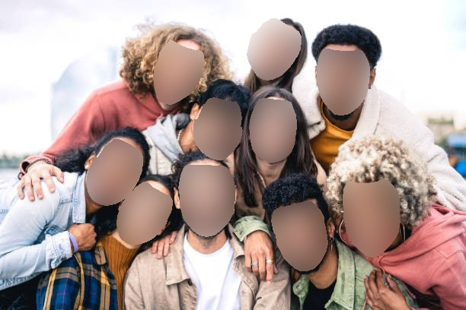
Face blur
Notes:
For implementing face-blurring filter we detect faces, mark 81 points on each face, draw a polygon around the face's contour, and apply a Gaussian blur. With the 68-point model, we had to fill in the forehead by mirroring the jawline (shown in the upper right picture). However, the switch to the 81-point model solved this issue (shown in the bottom right picture).

Slide 24
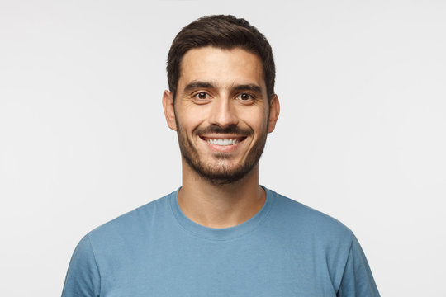
Masking
Notes:
Max: Let’s talk about masking that can be called in our tool. Let’s apply the face on the right as a mask to every face on the other image.

Slide 25
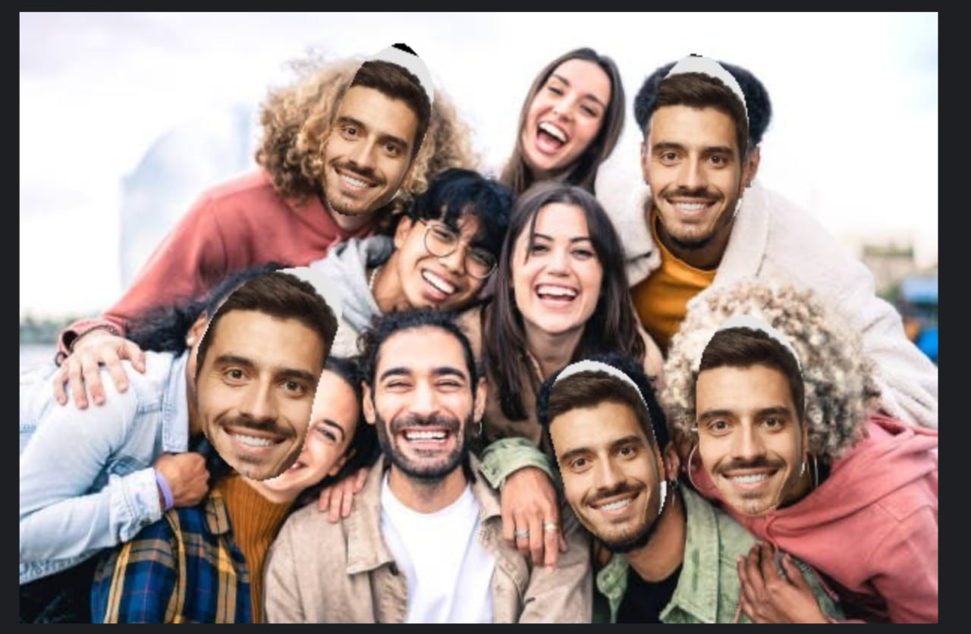
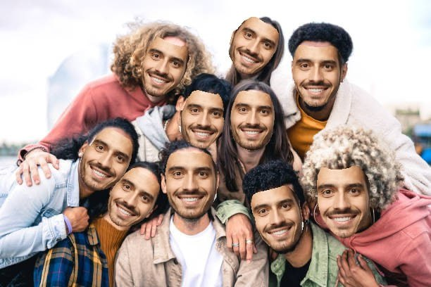
Notes:
Max: There you can see two results. First version: we’ve used only blazzeface from mediapipe, that couldn’t find all the faces. Also, we’ve performed overlaying masks with reflecting jawline to create the area for masking. Final version algo: Blazeface was used for finding landmarks on the image with the mask, and Dlib (81 points) was used for marking faces on the target image (because it can contain many faces).

Slide 26
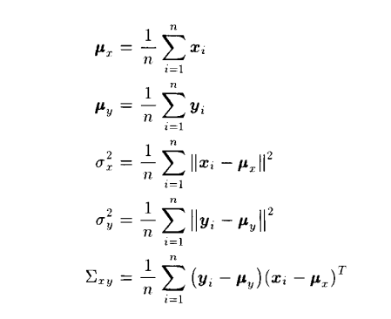
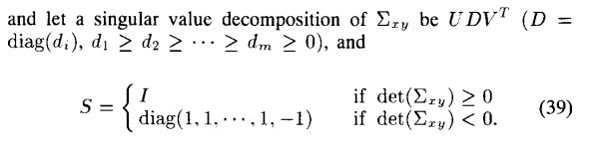
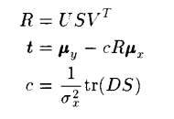
Affine transformation
Prove it as an exercise…
Notes:
Max: For every target face and the mask we calculate Rotation, Translation matrices and Scale coefficient with the Kabsch-Umeyama algo. Then we combine them into the Affine transform matrix, apply it to the mask image, and place the area of the face from the mask image to the target image.

Slide 27
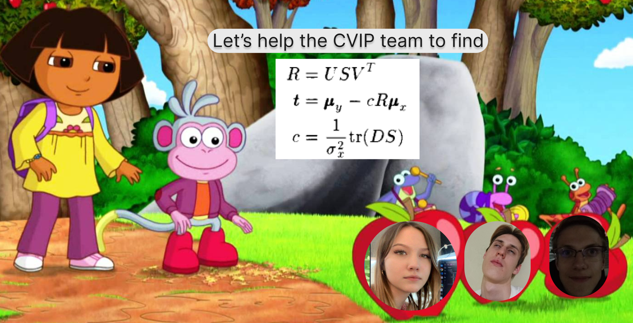
The end

